Slide 1


The PiXL Club The PiXL Club The PiXL Club The PiXL Club The PiXL Club The PiXL Club The PiXL Club The PiXL Club The PiXL Club The PiXL Club The PiXL Club The PiXL Club The PiXL Club The PiXL Club The PiXL Club The PiXL Club The PiXL Club The PiXL Club The PiXL Club The PiXL Club The PiXL Club The PiXL Club The PiXL Club The PiXL Club The PiXL Club The PiXL Club The PiXL Club The PiXL Club The PiXL Club The PiXL Club The PiXL Club The PiXL Club The PiXL Club The PiXL Club The PiXL Club The PiXL Club The PiXL Club The PiXL Club The PiXL Club The PiXL Club The PiXL Club The PiXL Club The PiXL Club The PiXL Club The PiXL Club XL Club The PiXL Club The PiXL Club The PiXL Club The PiXL Club The PiXL Club The PiXL Club The PiXL Club The PiXL Club The PiXL Club The PiXL Club The PiXL Club The PiXL Club The PiXL Club The PiXL Club The PiXL Club The PiXL Club The PiXL Club The PiXL Club The PiXL Club The PiXL Club The PiXL Club The PiXL Club The PiXL Club The PiXL Club The PiXL Club The PiXL Club The PiXL Club The PiXL Club The PiXL Club The PiXL Club The PiXL Club The PiXL Club The PiXL Club The PiXL Club The PiXL Club The PiXL Club The PiXL Club The PiXL Club The PiXL Club The PiXL Club The PiXL Club The PiXL Club The PiXL Club The PiXL Club The PiXL Club The PiXL Club The PiXL Club The PiXL Club The PiXL Club The PiXL Club The PiXL Club The PiXL Club The PiXL Club The PiXL Club The PiXL Club The PiXL Club The PiXL Club The PiXL Club The PiXL Club The PiXL Club The PiXL Club The PiXL Club The PiXL Club The PiXL Club The PiXL Club The PiXL Club The PiXL Club The PiXL Club The PiXL Club The PiXL Club The PiXL Club The PiXL Club The PiXL Club The PiXL Club The PiXL Club The PiXL Club The PiXL Club The PiXL Club The PiXL Club The PiXL Club The PiXL Club The PiXL Club The PiXL Club The PiXL Club The PiXL Club The PiXL Club The PiXL Club The PiXL Club The PiXL Club The PiXL Club The PiXL Club The PiXL Club The PiXL Club The PiXL Club The PiXL Club The PiXL Club The PiXL Club The PiXL Club The PiXL Club The PiXL Club The PiXL Club The PiXL Club The PiXL Club The PiXL Club The PiXL Club The PiXL Club The PiXL Club The PiXL Club The PiXL Club The PiXL Club The PiXL Club The PiXL Club The PiXL Club The PiXL Club The PiXL Club The PiXL Club The PiXL Club The PiXL Club The PiXL Club The PiXL Club The PiXL Club The PiXL Club The PiXL Club The PiXL Club The PiXL Club The PiXL Club The PiXL Club The PiXL Club The PiXL Club The PiXL Club The PiXL Club The PiXL Club The PiXL Club The PiXL Club The PiXL Club The PiXL Club The PiXL Club The PiXL Club The PiXL Club The PiXL Club The PiXL Club The PiXL Club The PiXL Club The PiXL Club The PiXL Club The PiXL Club The PiXL Club The PiXL Club The PiXL Club The PiXL Club The PiXL Club The PiXL Club The PiXL Club The PiXL Club The PiXL Club The PiXL Club The PiXL Club The PiXL Club The PiXL Club The PiXL Club The PiXL Club The PiXL Club The PiXL Club The PiXL Club The PiXL Club The PiXL Club The PiXL Club The PiXL Club The PiXL Club The PiXL Club The PiXL Club The PiXL Club The PiXL Club The PiXL Club The PiXL Club The PiXL Club The PiXL Club The PiXL Club The PiXL Club The PiXL Club The PiXL Club The PiXL Club The PiXL Club The PiXL Club The PiXL Club The PiXL Club The PiXL Club The PiXL Club The PiXL Club The PiXL Club The PiXL Club The PiXL Club The PiXL Club The PiXL Club The PiXL Club The PiXL Club The PiXL Club The PiXL Club The PiXL Club The PiXL Club The PiXL Club The PiXL Club The PiXL Club The PiXL Club The PiXL Club The PiXL Club The PiXL Club The PiXL Club The PiXL Club The PiXL Club The PiXL Club The PiXL Club The PiXL Club The PiXL Club The PiXL Club The PiXL Club The PiXL Club The PiXL Club The PiXL Club The PiXL Club The PiXL Club The PiXL Club The PiXL Club The PiXL Club The PiXL Club The PiXL Club The PiXL Club The PiXL Club The PiXL Club The PiXL Club The PiXL Club The PiXL Club The PiXL Club The PiXL Club The PiXL Club The PiXL Club The PiXL Club The PiXL Club The PiXL Club The PiXL Club The PiXL Club The PiXL Club The PiXL Club The PiXL Club The PiXL Club The PiXL Club The PiXL Club The PiXL Club The PiXL Club The PiXL Club The PiXL Club The PiXL Club The PiXL Club The PiXL Club The PiXL Club The PiXL Club The PiXL Club The PiXL Club The PiXL Club The PiXL Club The PiXL Club The PiXL Club The PiXL Club The PiXL Club The PiXL Club The PiXL Club The PiXL Club The PiXL Club The PiXL Club The PiXL Club The PiXL Club The PiXL Club The PiXL Club The PiXL Club The PiXL Club The PiXL Club The PiXL Club The PiXL Club The PiXL Club The PiXL Club The PiXL Club The PiXL Club The PiXL Club The PiXL Club The PiXL Club The PiXL Club The PiXL Club The PiXL Club The PiXL Club The PiXL Club The PiXL Club The PiXL Club The PiXL Club The PiXL Club The PiXL Club The PiXL Club The PiXL Club The PiXL Club The PiXL Club The PiXL Club The PiXL Club The PiXL Club The PiXL Club The PiXL Club The PiXL Club The PiXL Club The PiXL Club The PiXL Club The PiXL Club The PiXL Club The PiXL Club The PiXL Club The PiXL Club The PiXL Club The PiXL Club The PiXL Club The PiXL Club The PiXL Club The PiXL Club The PiXL Club The PiXL Club The PiXL Club The PiXL Club The PiXL Club The PiXL Club The PiXL Club The PiXL Club The PiXL Club The PiXL Club The PiXL Club The PiXL Club The PiXL Club The PiXL Club The PiXL Club The PiXL Club The PiXL Club The PiXL Club The PiXL Club The PiXL Club The PiXL Club The PiXL Club The PiXL Club The PiXL Club The PiXL Club The PiXL Club The PiXL Club The PiXL Club The PiXL Club The PiXL Club The PiXL Club The PiXL Club The PiXL Club The PiXL Club The PiXL Club The PiXL Club The PiXL Club The PiXL Club The PiXL Club The PiXL Club The PiXL Club The PiXL Club The PiXL Club The PiXL Club The PiXL Club The PiXL Club The PiXL Club The PiXL Club The PiXL Club The PiXL Club The PiXL Club The PiXL Club The PiXL Club The PiXL Club The PiXL Club The PiXL Club The PiXL Club The PiXL Club The PiXL Club The PiXL Club The PiXL Club The PiXL Club The PiXL Club The PiXL Club The PiXL Club The PiXL Club The PiXL Club The PiXL Club The PiXL Club The PiXL Club The PiXL Club The PiXL Club The PiXL Club The PiXL Club The PiXL Club The PiXL Club The PiXL Club The PiXL Club The PiXL Club The PiXL Club The PiXL Club The PiXL Club The PiXL Club The PiXL Club The PiXL Club The PiXL Club The PiXL Club The PiXL Club The PiXL Club The PiXL Club The PiXL Club The PiXL Club The PiXL Club The PiXL Club The PiXL Club The PiXL Club The PiXL Club The PiXL Club The PiXL Club The PiXL Club The PiXL Club The PiXL Club The PiXL Club The PiXL Club The PiXL Club The PiXL Club The PiXL Club The PiXL Club The PiXL Club The PiXL Club The PiXL Club The PiXL Club The PiXL Club The PiXL Club The PiXL Club The PiXL Club The PiXL Club The PiXL Club The PiXL Club The PiXL Club The PiXL Club The PiXL Club The PiXL Club The PiXL Club The PiXL Club The PiXL Club The PiXL Club The PiXL Club The PiXL Club The PiXL Club The PiXL Club The PiXL Club The PiXL Club The PiXL Club The PiXL Club The PiXL Club The PiXL Club The PiXL Club The PiXL Club The PiXL Club The PiXL Club The PiXL Club The PiXL Club The PiXL Club The PiXL Club The PiXL Club The PiXL Club The PiXL Club The PiXL Club The PiXL Club The PiXL Club The PiXL Club The PiXL Club The PiXL Club The PiXL Club The PiXL Club The PiXL Club The PiXL Club The PiXL Club The PiXL Club The PiXL Club The PiXL Club The PiXL Club The PiXL Club The PiXL Club The PiXL Club The PiXL Club The PiXL Club The PiXL Club The PiXL Club The PiXL Club The PiXL Club The PiXL Club The PiXL Club The PiXL Club The PiXL Club The PiXL Club The PiXL Club The PiXL Club The PiXL Club The PiXL Club The PiXL Club The PiXL Club The PiXL Club The PiXL Club The PiXL Club The PiXL Club The PiXL Club The PiXL Club The PiXL Club The PiXL Club The PiXL Club The PiXL Club The PiXL Club The PiXL Club The PiXL Club The PiXL Club The PiXL Club The PiXL Club The PiXL Club The PiXL Club The PiXL Club The PiXL Club The PiXL Club The PiXL Club The PiXL Club The PiXL Club The PiXL Club The PiXL Club The PiXL Club The PiXL Club The PiXL Club The PiXL Club The PiXL Club The PiXL Club The PiXL Club The PiXL Club The PiXL Club The PiXL Club The PiXL Club The PiXL Club The PiXL Club The PiXL Club The PiXL Club The PiXL Club The PiXL Club The PiXL Club The PiXL Club The PiXL Club The PiXL Club The PiXL Club The PiXL Club The PiXL Club The PiXL Club The PiXL Club The PiXL Club The PiXL Club The PiXL Club The PiXL Club The PiXL Club The PiXL Club The PiXL Club The PiXL Club The PiXL Club The PiXL Club The PiXL Club The PiXL Club The PiXL Club The PiXL Club The PiXL Club The PiXL Club The PiXL Club The PiXL Club The PiXL Club The PiXL Club The PiXL Club The PiXL Club The PiXL Club The PiXL Club The PiXL Club The PiXL Club The PiXL Club The PiXL Club The PiXL Club The PiXL Club The PiXL Club The PiXL Club The PiXL Club The PiXL Club The PiXL Club The PiXL Club The PiXL Club The PiXL Club The PiXL Club The PiXL Club The PiXL Club The PiXL Club The PiXL Club The PiXL Club The PiXL Club The PiXL Club The PiXL Club The PiXL Club The PiXL Club The PiXL Club The PiXL Club The PiXL Club The PiXL Club The PiXL Club The PiXL Club The PiXL Club The PiXL Club The PiXL Club The PiXL Club The PiXL Club The PiXL Club The PiXL Club The PiXL Club The PiXL Club The PiXL Club The PiXL Club The PiXL Club The PiXL Club The PiXL Club The PiXL Club The PiXL Club The PiXL Club The PiXL Club The PiXL Club The PiXL Club The PiXL Club The PiXL Club The PiXL Club The PiXL Club The PiXL Club The PiXL Club The PiXL Club The PiXL Club The PiXL Club The PiXL Club The PiXL Club The PiXL Club The PiXL Club The PiXL Club The PiXL Club The PiXL Club The PiXL Club The PiXL Club The PiXL Club The PiXL Club The PiXL Club The PiXL Club The PiXL Club The PiXL Club The PiXL Club The PiXL Club The PiXL Club The PiXL Club The PiXL Club The PiXL Club The PiXL Club The PiXL Club The PiXL Club The PiXL Club The PiXL Club The PiXL Club The PiXL Club The PiXL Club The PiXL Club The PiXL Club The PiXL Club The PiXL Club The PiXL Club The PiXL Club The PiXL Club The PiXL Club The PiXL Club The PiXL Club The PiXL Club The PiXL Club The PiXL Club The PiXL Club The PiXL Club The PiXL Club The PiXL Club The PiXL Club The PiXL Club The PiXL Club The PiXL Club The PiXL Club The PiXL Club The PiXL Club The PiXL Club The PiXL Club The PiXL Club The PiXL Club The PiXL Club The PiXL Club The PiXL Club The PiXL Club The PiXL Club
PiXL KnowIT!
GCSE Chemistry
AQA Topic – Chemical Analysis
© Copyright The PiXL Club Ltd, 2017
This resource is strictly for the use of member schools for as long as they remain members of The PiXL Club. It may not be copied, sold nor transferred to a third party or used by the school after membership ceases. Until such time it may be freely used within the member school.
All opinions and contributions are those of the authors. The contents of this resource are not connected with nor endorsed by any other company, organisation or institution.
www.pixl.org.uk The PiXL Club Ltd, Company number 07321607

Slide 2
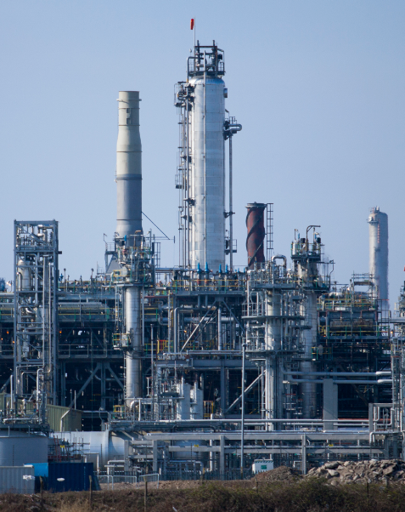
Overview
Chemical Analysis
Purity, formulations and chromatography
  Pure substances
  Formulations
  Chromatography
Identification of common gases
  Test for hydrogen
  Test for oxygen
  Test for carbon dioxide
  Test for chlorine
Identification of ions by chemical and
spectroscopic means (Chemistry only)
Flame tests
Metal hydroxides
Carbonates
Halides
Sulfates
Instrumental methods
Flame emission spectroscopy

Slide 3
LearnIT!
KnowIT!
Purity, formulations
And chromatography
  Pure substances
  Formulations
  Chromatography

Slide 4
  Pure substances and Formulations
In chemistry, a pure substance is a single element or compound not mixed with any other substance.
Learn this definition for the exam
Pure substances have specific melting and boiling temperatures.
These can be used to distinguish pure substances from mixtures.
Melting point of a pure substance
Melting point of an impure substance
In Science we would not refer a substance such as milk as being pure as it is a mixture of a number of different substances.
A formulation is a mixture that has been designed as a useful product.
Formulations are made by mixing the components in carefully measured quantities to ensures that the product has the required properties. Formulations include fuels, cleaning agents, paints, medicines, alloys, fertilisers and foods

Slide 5
  Chromatography
Position solvent reaches
Chromatography can be used to separate mixtures.
Chromatography involves a stationary phase and a mobile phase.
Parts of mixture separated
The ratio of the distance moved by a compound (centre of spot from origin) can be expressed as it’s R_{f} value:
R_{f} = distance moved by substance
distance moved by solvent
When calculating the R_{f} value remember the solvent will always travel further than the substance so the R_{f} value can never be greater than 1.
Mixture to be separated
Solvent
Different compounds have different Rf values in different solvents, which can be used to help identify the compounds. A pure compound will produce a single spot in all solvents.

Slide 6
QuestionIT!
Purify, formulations and chromatography
Purity
Formulations
Chromatography

Slide 7
  Purity, Formulations and Chromatography – QuestionIT
What is a pure substance?
How could you distinguish between a pure substance and a mixture?
What is a formulation?
How are formulations made?
Give two examples of formulations.

Slide 8
  Purity, Formulations and Chromatography – QuestionIT
What is chromatograph?
What happens in the stationary and mobile phases?
State the equation used to find the Rf value.
A solvent travels 8cm up the stationary phase, two spots separate out. A travels 6cm up the mobile phase, B travels 4.5cm up the mobile phase. Give the Rf value for both to two decimal places.

Slide 9

AnswerIT!
Purify, formulations and chromatography
Purity
Formulations
Chromatography

Slide 10
  Purity, Formulations and Chromatography – QuestionIT
What is a pure substance?
  A single element or compound, not mixed with any other substance.
How could you distinguish between a pure substance and a mixture?
  Pure substances melt and boil at specific temperatures. Melting and boiling point data could be used.
What is a formulation?
  A mixture that has been designed as a useful product.
How are formulations made?
  Mixing the components in carefully measured quantities to ensure the product has the required properties.
Give two examples of formulations.
  Fuels, cleaning agents, paints, medicines, alloys, fertilisers and foods.

Slide 11

  Purity, Formulations and Chromatography – QuestionIT
What is chromatograph?
  Used to help separate mixtures, can give information to help identify substances.
What happens in the stationary and mobile phases?
  Stationary phase is the paper; mobile phase is the solvent. Mixture is dissolved in the solvent and moves up the stationary phase.
State the equation used to find the Rf value.
  Rf = $\frac{distance moved by substance}{distance moved by solvent}$
A solvent travels 8cm up the stationary phase, two spots separate out. A travels 6cm up the mobile phase, B travels 4.5cm up the mobile phase. Give the Rf value for both to two decimal places.
  A = 0.75, B= 0.56

Slide 12
LearnIT!
KnowIT!
Identification of
common gases
Test for hydrogen
Test for oxygen
Test for carbon dioxide
Test for chlorine

Slide 13
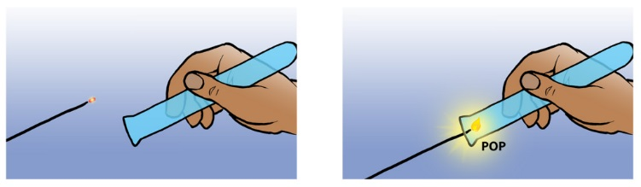
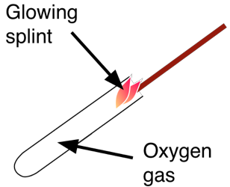
  Identification of common gases
Test For Hydrogen
The test for hydrogen uses a burning splint held at the open end of a test tube of the gas. Hydrogen burns rapidly with a pop sound.
Test For Oxygen
The test for oxygen uses a glowing splint inserted into a test tube of the gas. The splint relights in oxygen.
You must learn all of these tests, including how the gas is tested and the positive result that proves that the chemical is the gas you are testing for.

Slide 14
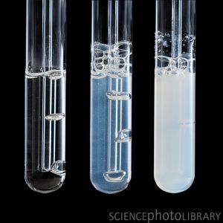
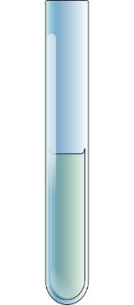
  Identification of common gases
Test For Carbon Dioxide
The test for carbon dioxide uses an aqueous solution of calcium hydroxide (lime water). When carbon dioxide is shaken or bubbled through limewater the limewater turns milky (cloudy).
Test For Chlorine
The test for chlorine uses litmus paper. When damp litmus paper is put into chlorine gas the litmus paper is bleached and turns white.
You must learn all of these tests, including how the gas is tested and the positive result that proves that the chemical is the gas you are testing for.

Slide 15
QuestionIT!
Identification of
common gases
Test for hydrogen
Test for oxygen
Test for carbon dioxide
Test for chlorine

Slide 16
  Identification of common gases – QuestionIT
How would you test for oxygen gas?
An unknown gas gives out a squeaky pop when a burning splint is put into it. What is the gas?
Describe how you would test for carbon dioxide gas.
A student wrote down the following description for testing chlorine: “Use litmus paper it turns from red to blue.” Where has he gone wrong?

Slide 17
AnswerIT!
Identification of
common gases
Test for hydrogen
Test for oxygen
Test for carbon dioxide
Test for chlorine

Slide 18
  Identification of common gases – QuestionIT
How would you test for oxygen gas?
  Glowing splint; splint relights.
An unknown gas gives out a squeaky pop when a burning splint is put into it. What is the gas?
  Hydrogen.
Describe how you would test for carbon dioxide gas.
  Limewater; turns cloudy/milky.
A student wrote down the following description for testing chlorine: “Use litmus paper it turns from red to blue.” Where has he gone wrong?
  Moist litmus paper; litmus paper is bleached, turns white.

Slide 19
LearnIT!
KnowIT!
Identification of ions by chemical means (Chemistry only) Part 1
Flame tests
Metal hydroxides

Slide 20
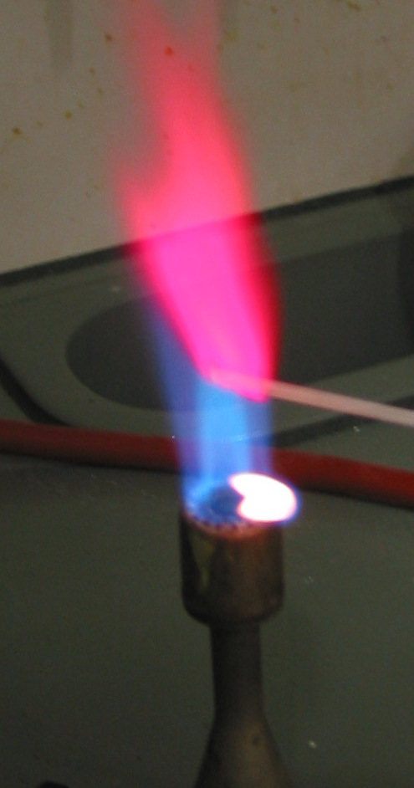
  Identification of ions by chemical means Part 1 (Chemistry only)
Flame Tests
Flame tests can be used to identify some metal ions (cations).
Lithium compounds results in a crimson flame.
Sodium compounds result in a yellow flame.
Potassium compounds result in a lilac flame.
Calcium compounds result in orange-red flame.
Copper compounds result in a green flame.
All of these colours are distinctive and can be used to identify these metal ions.
If a sample containing a mixture of ions is tested then some of flame colours can be masked and so will not be seen.

Slide 21
  Identification of ions by chemical means Part 1(Chemistry only)
Metal Hydroxides
Sodium hydroxide solution can be used to identify some metal ions (cations).
Sodium hydroxide is added to a solution of the metal ion to be tested, a solid precipitate (often coloured) is formed and can be used to identify the metal ion.
Aluminium, calcium and magnesium ions form white precipitates when sodium hydroxide solution is added, but only the aluminium hydroxide precipitate dissolves in excess sodium hydroxide solution.
Coloured precipitates
Copper (II) ions form a blue precipitate.
Iron (II) ions form a green precipitate.
Iron (III) ions form a brown precipitate
when sodium hydroxide solution is added.

Slide 22
  Identification of ions by chemical means Part 1 (Chemistry only)
You will be expected to write word and balanced symbol equations for all the precipitation reactions.
Aluminium chloride + sodium hydroxide → aluminium hydroxide + sodium chloride
AlCl₃ (aq) + 3NaOH (aq) → Al(OH)₃ (s) + 3NaCl (aq)
Calcium chloride + sodium hydroxide → calcium hydroxide + sodium chloride
CaCl₂ (aq) + 2NaOH (aq) → Ca(OH)₂ (s) + 2NaCl (aq)
Magnesium chloride + sodium hydroxide → magnesium hydroxide + sodium chloride
MgCl₂ (aq) + 2NaOH (aq) → Mg(OH)₂ (s) + 2NaCl (aq)
Copper(II) chloride + sodium hydroxide → copper (II) hydroxide + sodium chloride
CuCl₂ (aq) + 2NaOH (aq) → Cu(OH)₂ (aq) + 2NaCl (aq)
Iron (II) chloride + sodium hydroxide → iron (II) hydroxide + sodium chloride
FeCl₂ (aq) + 2NaOH (aq) → Fe(OH)₂ (s) + 2NaCl (aq)
Iron (III) chloride + sodium hydroxide → iron (III) hydroxide + sodium chloride
FeCl₃ (aq) + 3NaOH (aq) → Fe(OH)₃ (s) + 3NaCl (aq)

Slide 23
QuestionIT!
Identification of ions by chemical means (Chemistry only) Part 1
Flame tests
Metal hydroxides

Slide 24
  Identification of ions by chemical means Part 1 (Chemistry only)– QuestionIT
What is a flame test?
What colour flame would the following metal ions have in a flame test?
  Lithium
  Sodium
  Potassium
  Calcium
  Copper
What might cause some flame colours to be masked?

Slide 25
  Identification of ions by chemical means Part 1 (Chemistry only)– QuestionIT
What is a precipitate?
Sodium hydroxide is used to identify some metal ions. What colour precipitate do aluminium, calcium and magnesium ions form?
How is are aluminium ions distinguished from calcium and magnesium ions in the reaction with sodium hydroxide?
What colour precipitate do the following ions make with sodium hydroxide?
  Copper (II)
  Iron (II)
  Iron (III)

Slide 26
  Identification of ions by chemical means Part 1 (Chemistry only)– QuestionIT
Write the word equation for the reaction between calcium chloride and sodium hydroxide.
Write the balanced symbol equation for the reaction between aluminium chloride and sodium hydroxide.
What colour would be the precipitates be in the above reactions?
How could you distinguish between them?

Slide 27
AnswerIT!
Identification of ions by chemical means (Chemistry only) Part 1
Flame tests
Metal hydroxides

Slide 28
  Identification of ions by chemical means Part 1 (Chemistry only)– QuestionIT
What is a flame test?
  Rod dipped in water and then in the compound; placed in flame; observe colour of flame.
What colour flame would the following metal ions have in a flame test?
  Lithium crimson red
  Sodium yellow
  Potassium lilac
  Calcium orange-red
  Copper green
What might cause some flame colours to be masked?
  A sample containing a mixture of ions.

Slide 29
  Identification of ions by chemical means Part 1 (Chemistry only)– QuestionIT
What is a precipitate?
  A insoluble solid product produced in a liquid.
Sodium hydroxide is used to identify some metal ions. What colour precipitate do aluminium, calcium and magnesium ions form?
  White.
How is are aluminium ions distinguished from calcium and magnesium ions in the reaction with sodium hydroxide?
  Aluminium hydroxide precipitate dissolves in excess sodium hydroxide solution.
What colour precipitate do the following ions make with sodium hydroxide?
  Copper (II) blue
  Iron (II) green
  Iron (III) brown

Slide 30
  Identification of ions by chemical means Part 1 (Chemistry only)– QuestionIT
Write the word equation for the reaction between calcium chloride and sodium hydroxide.
  Calcium chloride + sodium hydroxide →
  calcium hydroxide + sodium chloride
Write the balanced symbol equation for the reaction between aluminium chloride and sodium hydroxide.
AlCl₃ (aq)+ 3NaOH (aq) → Al(OH)₃ (s) + 3NaCl (aq)
What colour would be the precipitates be in the above reactions?
  White.
How could you distinguish between them?
  Aluminium hydroxide would dissolve in excess sodium hydroxide.

Slide 31
LearnIT!
KnowIT!
Identification of ions by chemical means Part 2 (Chemistry only)
Carbonates
Halides
Sulfates

Slide 32
  Identification of ions by chemical means Part 2 (Chemistry only)
Identifying Carbonates
Carbonates react with dilute acids to form carbon dioxide gas. Carbon dioxide can be identified with limewater.
Identifying Halide Ions
Halide ions in solution produce precipitates with silver nitrate solution in the presence of dilute nitric acid.
Silver chloride is white.
Silver bromide is cream.
Silver iodide is yellow.
Identifying Sulfate Ions
Sulfate ions in solution produce a white precipitate with barium chloride in the presence of dilute hydrochloric acid.
Again you need to remember these colours and be able to write out the word and symbol equations shown on the next slide in the exam. Do not forget the state symbols.

Slide 33
  Identification of ions by chemical means Part 2 (Chemistry only)
Halide Ions
Sodium chloride + silver nitrate → sliver chloride + sodium chloride
NaCl (aq) + AgNO₃ (aq) → AgCl (s) + NaCl (aq)
Sodium bromide + silver nitrate → silver bromide + sodium chloride
NaBr (aq) + AgNO₃ (aq) → AgBr (s) + NaCl (aq)
Sodium iodide + silver nitrate → silver iodide + sodium chloride
NaI (aq) + AgNO₃ (aq) → AgI (s) + NaCl (aq)
Sulfate Ions
Barium chloride + sodium sulfate → barium sulfate + sodium chloride
BaCl₂ (aq) + Na₂SO₄ (aq) → BaSO₄ (s) + 2NaCl (aq)

Slide 34
QuestionIT!
Identification of ions by chemical means Part 2 (Chemistry only)
Carbonates
Halides
Sulfates

Slide 35
  Identification of ions by chemical means Part 2 (Chemistry only)QuestionIT
How would you test for a carbonate?
How would you test the gas produced by the above reaction?
How would you test for halide ions?
How could you use the above test to distinguish between halide ions?

Slide 36
  Identification of ions by chemical means Part 2 (Chemistry only)QuestionIT
Silver nitrate is added to an unknown chemical in solution. A cream precipitate is produced. What is the halide ion present?
(HT) Write the balanced ionic equation for the reaction above.
How would you test for sulfate ions?
Write the word and balanced symbol equation for the reaction between sodium sulfate and barium chloride.

Slide 37
AnswerIT!
Identification of ions by chemical means Part 2 (Chemistry only)
Carbonates
Halides
Sulfates

Slide 38
  Identification of ions by chemical means Part 2 (Chemistry only)QuestionIT
How would you test for a carbonate?
  React with dilute hydrochloric acid to form carbon dioxide gas.
How would you test the gas produced by the above reaction?
  Limewater goes cloudy/ milky.
How would you test for halide ions?
  Produce precipitate with silver nitrate in the presence of nitric acid.
How could you use the above test to distinguish between halide ions?
  Silver chloride = white; silver bromide = cream;
  silver iodide = yellow.

Slide 39
  Identification of ions by chemical means Part 2 (Chemistry only)QuestionIT
Silver nitrate is added to an unknown chemical in solution. A cream precipitate is produced. What is the halide ion present?
  Bromide.
(HT) Write the balanced ionic equation for the reaction above.
  Ag⁺_{(aq)} + Br ⁻_{(aq)} → AgBr_{(s)}
How would you test for sulfate ions?
  Add barium chloride solution in the presence of hydrochloric acid; white precipitate formed.
Write the word and balanced symbol equation for the reaction between sodium sulfate and barium chloride.
Barium chloride + sodium sulfate → barium sulfate + sodium chloride
BaCl₂ (aq) + Na₂SO₄ (aq) → BaSO₄ (s) + 2NaCl (aq)

Slide 40
LearnIT!
KnowIT!
Identification of ions by instrumental methods (Chemistry only)
Instrumental methods
Flame emission spectroscopy

Slide 41
  Identification of ions by instrumental methods (Chemistry only)
Elements and compounds can be detected and identified using instrumental methods.
Instrumental methods are:
Accurate
Sensitive
Rapid
Flame emission spectroscopy is used to analyse metal ions in solution.
The sample is put into a flame and the light given out is passed through a spectroscope.
The output is a line spectrum that can be analysed to identify the metal ions in the solution and measure their concentrations.
Lithium
Sodium
potassium
These are the advantages of using instrumental methods compared with the earlier chemical tests, you need to know these for the exam.
wavelength 400 450 500 550 600 650 700
In nm
Each metal has their own patterns of bands which allows them to be identified as being present in the solution.

Slide 42
QuestionIT!
Identification of ions by instrumental methods (Chemistry only)
Instrumental methods
Flame emission spectroscopy

Slide 43
  Identification of ions by instrumental methods (Chemistry only)QuestionIT
1. Give three advantages of instrumental methods for detecting ions compared with chemical methods.
2. What is flame emission spectroscopy used for?
3. How is flame emission spectroscopy carried out?

Slide 44
  Identification of ions by instrumental methods (Chemistry only)QuestionIT
4. Five different samples were analysed using flame emission spectroscopy, the results are shown below. Which two of the results show the same metal?
A
B
C
D
E

Slide 45
AnswerIT!
Identification of ions by instrumental methods (Chemistry only)
Instrumental methods
Flame emission spectroscopy

Slide 46
  Identification of ions by instrumental methods (Chemistry only)AnswerIT
1. Give three advantages of instrumental methods for detecting ions compared with chemical methods.
accurate/sensitive/rapid
2. What is flame emission spectroscopy used for?
To analyse metal ions in solution.
3. How is flame emission spectroscopy carried out?.
Sample is put into a flame, light given out is passed through a spectroscope, line spectrum produced is analysed to identify metal ions

Slide 47
  Identification of ions by instrumental methods (Chemistry only)AnswerIT
4. Five different samples were analysed using flame emission spectroscopy, the results are shown below. Which two of the results show the same metal?
A
B
C
D
E
A and D

